Slide 1

.NET Core: Developing Cross-Platform Web Apps with ASP.NET Core – WorkshopPLUS
< Engineer Name >
Premier Field Engineer
v3.1

Slide 2
For more information, see Use of Microsoft Copyrighted Content at
http://www.microsoft.com/en-us/legal/intellectualproperty/Permissions/default.aspx
Azure, Internet Explorer, Microsoft, SQL Server, Visual Studio, and Windows are either registered trademarks or trademarks of Microsoft Corporation in the United States and/or other countries. Other Microsoft products mentioned herein may be either registered trademarks or trademarks of Microsoft Corporation in the United States and/or other countries. All other trademarks are property of their respective owners.

Slide 3
How to View This Presentation
To switch to Notes Page view:
On the ribbon, click the View tab, and then click Notes Page
To navigate through notes, use the Page Up and Page Down keys
Zoom in or zoom out, if required
In the Notes Page view, you can:
Read any supporting text
Terminology List—a list of terms used in this course is provided in the Notes section.
Add notes to your copy of the presentation, if required
Take the presentation files home with you
Notes:
Terminology List:

Slide 4
Module 5: Web API
Module Overview
Notes:
This module includes the following sections:
Section 1: RESTful Services
Section 2: ASP.NET Core Web API
Section 3: Web API Usage Patterns
After this module, you will be able to:
Use ASP.NET Web API to create REST based services, learn best practices on how to design and develop them well, and finally how to secure them to prevent unauthorized access.

Slide 5
Module 5: Web API
Section 1: RESTful Services
Lesson: REST Fundamentals

Slide 6
What is Representational State Transfer?
REST defines a set of design principles and architectural styles for highly scalable distributed systems
REST is coined by Roy Fielding in his PhD thesis in 2000
Roy is also the principle author of the HTTP specification and the co-author of the Uniform Resource Identifier (URI) specification
The World Wide Web is an existing proof of a massively scalable distributed system that follows REST principles
Notes:
REST is attempting to learn from the practical success of the web characterizing its design and the principles behind, to come up with guidance for an architecture that provides the same/similar benefits.
For more information, see: http://www.xfront.com/REST-Web-Services.html

Slide 7

What is REST?
Roy’s definition:
“The name Representational State Transfer is intended to evoke an image of how a well-designed Web application behaves: a network of web pages (a virtual state-machine), where the user progresses through the application by selecting links (state transitions), resulting in the next page (representing the next state of the application) being transferred to the user and rendered for their use”
Notes:
The motivation behind the development of REST was to create a design pattern for how the Web should work, so that it could act as a guiding framework for the Web standards and designing Web services. REST itself is not a standard but it prescribes the use of standards such as HTTP, URL, and XML/HTML/JPEG.

Slide 8
REST Principles
Identifiable resources
Give everything an ID
Resource representations
Resources with multiple representations
Hypermedia as the Engine of Application State (HATEOAS)
Link resources together
Uniform Interface
Use standard methods
Stateless communication
Communicate in a stateless fashion
Notes:
REST-style architectures consist of clients and servers. Clients initiate requests to servers who process these requests and return responses based on these requests. These requests and responses are built around the transfer of representations of these resources. A resource can be any coherent and meaningful concept that can be addressed, while a representation of a resource is a document that captures the intended state of a resource. Fundamentally in REST each resource is first identified using a URL and a new resource for every service required is created. The data returned by the service must be linked to the other data, hence making it into a network of information unlike the Object Oriented design which encourages the encapsulation of information
For more information, see: http://en.wikipedia.org/wiki/HATEOAS
HATEOAS
A REST client needs no prior knowledge about how to interact with any particular application or server beyond a generic understanding of hypermedia

Slide 9
Resources
Fundamental building blocks for the web
REST is resource-centric: State and functionality
Anything exposed to the web from a document or a video to a business service that the consumer can interact with
Examples from Twitter
Users | Statuses
Followers | User_timeline
Trends | Home_timeline
 | Retweets_of_me
 | Retweets
 | Retweeters
Notes:
Resources are exposed in terms of state and resources can only interact through exchange of state.

Slide 10
Resource - Centric Architecture
Addressable
Stateless
Resource
Uniform Interface
Connected
Notes:
Uniform Interface
HTTP Verbs
GET, PUT, POST, DELETE, etc.
Addressable
Stateless
Connected
Hyperlinks connect resources to one another

Slide 11
Resource Representations
Resource can have multiple representations, for example, HTML, XHTML, XML, JSON, plain text, multimedia, Atom, etc.
Content negotiation allows client to specify the type of content it can accept and preference: “I want XML”
MIME defines some standard content types:
“text/plain”
“text/html”
“image/jpeg”
“audio/mp3” and so on.

Slide 12
Hypermedia
Follow your nose or links
Ability to link resources via URIs is the “state transfer” aspect of REST
Server can update links and clients simply follow them
Hypermedia As The Engine Of Application State (HATEOAS)
Links are not restricted to human users. Applications can also use them as well
Notes:
Obvious benefit of hypermedia controls is that it allows the server to change its URI scheme without breaking clients.
Links give client developers a hint as to what may be possible next. It does not give all the information.
Similarly, links allow the server team to advertise new capabilities by putting new links in the responses.
Roy Fielding made it clear that hypermedia controls are a pre-condition of REST.

Slide 13
Uniform Resource Identifier (URI)
URI uniquely identifies a resource globally
It allows a resource to be addressable and capable of being manipulated using an application protocol such as HTTP
A URI identifies a single resource, but a single resource can have more than one URI: One-to-Many relationship
For example, an atom feed of orders for a particular customer.
Human-readable URIs are not required to be RESTful
Embrace the URI:
How to get it: scheme: http://
Where to get it: contoso.com
What to get: modules
http://
/modules
Notes:
IMPORTANT: The URI on the slide does not exist or if it does if it is just a coincidence. Emphasize this when going over this slide.
While human-readable or predictable URIs are nice and good practice, they are not a rule of REST.

Slide 14
Uniform Interface
Every resource supports the same interface
In HTTP, this interface is
HTTP verbs: GET, PUT, POST, DELETE, HEAD, OPTIONS
HTTP status codes
Safe operations: Idempotence
If an operation is executed twice the results are the same e.g. two Put requests with same data
Advantages
Simplicity
Stateless with respect to client and server communication
Extensibility
Mashups, MIME types, etc.
Visibility
URIs, Verbs, headers provide for services like caching
Notes:
Idempotence is the property of certain operations in mathematics and computer science, that they can be applied multiple times without changing the result beyond the initial application. The concept of idempotence arises in a number of places in abstract algebra (in particular, in the theory of projectors and closure operators) and functional programming (in which it is connected to the property of referential transparency).
In normal language Idempotence means execute the same operation twice will not change results:
Get is idempotent because is a read only operation, in other words, Get never changes data.
Put with same data is idempotent because no matter how many times we do the same request the result will be the same.
Delete is not exactly idempotent because first time a resource is deleted the response will be 200 or 204 and in a second delete for same Id the response will be a 404. However the practical result will be the same.
Post is not idempotent because any post creates a new resource.
Nice explanation here: https://www.restapitutorial.com/lessons/idempotency.html
Advantages of a Uniform Interface:
Simplicity: No resource or application-specific interfaces that can lead to a proliferation of proprietary interfaces that lead to client/server coupling and dependencies and implementation that need to be managed out-of-band. A set of well-defined interfaces such as HTTP verbs used throughout.
Extensibility: Each and every resource uses the same Uniform Interface, which means disparate services can be mashed up together. Also, MIME type extensibility.
Visibility: URI, method, etc. enables intermediaries to provide services such as caching, security that help with scaling.

Slide 15
Why REST?
Move towards a resource-based application model
Interoperability between cloud, on-premises and cross-domains
Take advantage of Web’s infrastructure
Easy composition of resources via Uniform Interface
A “must have” if your APIs will be consumed by third-party services
Notes:
Easy composition
Resources from different sources and applications can be linked together to mash things up, to provide richer applications, services, and interactions.

Slide 16
Demo: Online REST Web Service
Notes:
Demo script:
Navigate to https://api.predic8.de/shop/docs to show the Swagger documentation of a web service:
Navigate to https://api.predic8.de/shop/categories/ and explain that the response is a list of Categories in json format.
Navigate to https://api.predic8.de/shop/categories/fruits to get a list of products in the category Fruits.
Navigate to https://api.predic8.de/shop/products/50 to retrieve the details of a product.
Go to the https://api.predic8.de/shop/customers/ to see the list of customers.
Obtain a list of orders for a customer navigating to https://api.predic8.de:443/shop/customers/2/orders/
Request a detail of an order; for example, https://api.predic8.de/shop/orders/2249
At the order details, you will also have a link to the customer and to order items. Try navigate to order items https://api.predic8.de/shop/orders/2249/items/
It is quite self-explanatory; the docs link is all you need to navigate without further knowledge of the service. You can also do the demo from the links in the documentation page and expend less time later in the Swagger topic.

Slide 17
Module 5: Web API
Section 2: ASP.NET Core Web API
Lesson: Web API Fundamentals

Slide 18
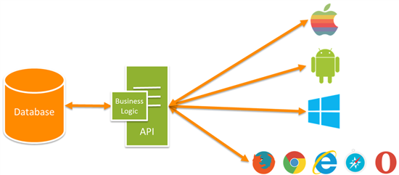

Web API
Notes:
HTTP is not just for serving up web pages. It is also a powerful platform for building APIs that expose services and data. HTTP is simple, flexible, and ubiquitous. Almost any platform that you can think of has an HTTP library, so HTTP services can reach a broad range of clients, including browsers, mobile devices, and traditional desktop applications.

Slide 19
ASP.NET Web API
ASP.NET Web API is a framework that makes it easy to build HTTP services.
Full support for ASP.NET Routing
Content negotiation and custom formatters
Model binding and validation
Filters
Query composition
Easy to unit test
Inversion of Control (IoC)
Code-based configuration
Self hosting
Notes:
Give a brief overview of the ASP.NET Web API features.
What is a Web API?
Web API is a HTTP service. What that means is here the API deals relies on HTTP constructs like headers and status codes. These are the first class citizens of the API and to program a Web API you need to be aware of these constructs.
Web API is designed for a broad reach in terms clients. In fact, the key advantage of Web API is the reach; reach in terms of clients it supports; the range is: wide browsers, mobile devices, thick client say .NET based WPF application and for that matter set top boxes.
Web API uses HTTP as an application protocol and not merely as a transport protocol which is what you do say in case of WCF where you send a SOAP envelop on top of HTTP protocol where all you use from HTTP side is a POST request. Not in the case of Web API, here you make use of quite a few of HTTP methods the most commonly ones being Get, Post, Put and Delete. This is one of the reason why it is able to support so many clients; so if your client can create a stream of HTTP request you can call a Web API based service.

Slide 20
The World Today with ASP.NET Core
MVC/Web API
Razor
HTML/Tag Helpers
Controllers (ControllerBase)
Actions
Filters
Model binding
Notes:
A base class for an MVC controller without view support. https://docs.microsoft.com/en-us/dotnet/api/microsoft.aspnetcore.mvc.controllerbase?view=aspnetcore-3.1
ASP.NET Core is an open source web framework for building modern web applications that can be developed and run on Windows, Linux and the Mac. It includes the MVC framework, which now combines the features of MVC and Web API into a single web programming framework. ASP.NET Core will also be the basis for SignalR 3 - enabling you to add real time functionality to cloud connected applications. ASP.NET Core is built on the .NET Core runtime, but it can also be run on the full .NET Framework for maximum compatibility.

Slide 21
Module 5: Web API
Section 2: ASP.NET Core Web API
Lesson: Routing

Slide 22
Routing - Controllers
ASP.NET Web API controllers derive from ControllerBase
[Route("api/[controller]")]
public class ValuesController : ControllerBase
Do not create Web Api controller deriving from Controller class
MVC Controller also derive from ControllerBase, but has code to deal with views
You can use RESTful style routing with both MVC and Web API controllers
Same routing framework for both MVC and the Web API
Convention-based routes or attribute routes
Default route template for Web API is "api/[controller]"
Notes:
MVC controllers derive from AspNet.Core.Mvc.Controller, API controllers derive from AspNet.Core.Mvc.ControllerBase.
Don't create a web API controller by deriving from the Controller class. Controller derives from ControllerBase and adds support for views, so it's for handling web pages, not web API requests. There's an exception to this rule: if you plan to use the same controller for both views and web APIs, derive it from Controller.
Details: https://docs.microsoft.com/en-us/aspnet/core/web-api/
In MVC Core both MVC controllers and Web API controllers use the same routes. You can use either convention-based routes or attribute routes and they apply to all controllers in a project.
MVC Core controllers return an IActionResult. When used as an MVC controller, the IActionResult might be a view. When used as a Web API controller, the IActionResult might be data (such as a list of products). The same controller might have actions that return both views and data.

Slide 23
IActionResult for UI and API
Controllers return IActionResult
For MVC Controllers, it might be view or data
For Web API controllers, it might be data
UI | API
PartialViewResult | BadRequestResult
RedirectResult | ContentResult
ViewResult | CreatedAtRouteResult
JsonResult | HttpStatusCodeResult
 | JsonResult
 | ObjectResult
ChallengeResult
HttpNotFoundResult
FileContentResult
Notes:
Part 1

Slide 24
IActionResult for UI and API
Controllers return IActionResult
For MVC Controllers, it might be view or data
For Web API controllers, it might be data
[HttpGet("{id:int}")]
public IActionResult GetById(int id)
{
var item = _items.FirstOrDefault(x => x.Id == id);
if (item == null)
{
return NotFound();
}
return new ObjectResult(item);
}
Notes:
Part 2

Slide 25
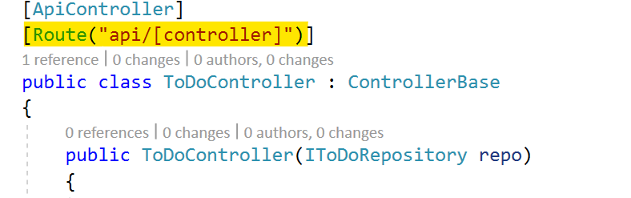
Routing - Controllers
To find the controller, Web API adds "Controller" to the value of the [controller] variable.
Once a matching route is found, Web API selects the controller
Web API uses the HTTP method, not the URI path, to select the action
If no route matches, the client receives a 404 error

Slide 26
Routing - Actions
Web API looks at the HTTP method, and then looks for an action whose HTTP attribute is the same as the method
This convention applies to GET, POST, PUT, and DELETE methods
Other placeholder variables in the route template, such as {id} and query strings, are mapped to action parameters.
[HttpGet("{id}")]
public string Select(int id)
[FromBody] attribute tells the framework that the parameter should be deserialized from the request body and not from URI
[HttpPut("{id:int}")]
public void Update(int id, [FromBody]string value)

Slide 27
HTTP Verbs
 | Collection URI (http://api.example.com/v1/resources/) | Element URI (http://api.example.com/v1/resources/item17)
GET | List the URIs and perhaps other details of the collection's members. | Retrieve a representation of the addressed member of the collection.
PUT | Replace the entire collection with another collection. | Replace the addressed member of the collection, or if it does not exist, create it.
POST | Create a new entry in the collection. | Treat the addressed member as a collection in its own right and create a new entry in it.
DELETE | Delete the entire collection. | Delete the addressed member of the collection.
Notes:
GET
Collection: List the URIs and perhaps other details of the collection's members.
Element: Retrieve a representation of the addressed member of the collection, expressed in an appropriate Internet media type.
PUT
Collection: Replace the entire collection with another collection.
Element: Replace the addressed member of the collection, or if it does not exist, create it.
POST:
Collection: Create a new entry in the collection. The new entry's URI is assigned automatically and is usually returned by the operation.
Element: Not generally used. Treat the addressed member as a collection in its own right and create a new entry in it.
DELETE
Collection: Delete the entire collection.
Element: Delete the addressed member of the collection.

Slide 28
Routing - Actions
Verb | URL | Action
GET | api/values | [HttpGet] public IEnumerable<string> Get()
GET | api/values/5 | [HttpGet("{id}")] public string Select(int id)
PUT | api/values/5 | [HttpPut("{id}")] public void Update(int id, [FromBody]string value)
POST | api/values | [HttpPost] public void Create([FromBody]string value)
DELETE | api/values/5 | [HttpDelete("{id}")] public void Delete(int id)
To prevent a method from getting invoked as an action, use the NonAction attribute
In case multiple Actions match, you get runtime exception:
500 Internal Server Error - Microsoft.AspNetCore.Mvc.AmbiguousActionException
Notes:
Unlike older versions, action name does not have to begin with HTTP method name!

Slide 29
Test and Debug Web APIs
Developer tools in browser are not enough to debug Web APIs
Need tools that offer more control to issue HTTP requests and check responses
UI Tools:
Telerik’s Fiddler
Swiss knife for HTTP debugging
Capture and replay requests
Inspect requests/responses
Compose requests
Postman
Compose requests
Inspect responses
More user friendly
Organize requests in collections
Command Line Tools
HTTPRepl
Multiplatform .Net Tool
Support for Swagger
Dotnet tool install –g Microsoft.dotnet-httprepl
Curl
Powershell: Invoke-Webrequest
Notes:
More details on tools:
Fiddler: https://www.telerik.com/fiddler
Postman: https://www.postman.com/product/api-client
HTTPRepl: https://docs.microsoft.com/en-us/aspnet/core/web-api/http-repl

Slide 30
Demo: Web API Controllers
Notes:
Demo script:
Open the project WebAPIDemo
Open ToDoItem.cs file in the Models folder and show the structure of the ToDoItem class.
Open ToDoController.cs file in the Controllers folder and explain the code:
Show the Route attribute on top of the class declaration.
Explain the action methods, show the selectors attributes (HttpGet, HttpPost,…) and explain what HTTP verb will trigger each action.
The [FromBody] attribute tells MVC to get the value of the to-do item only from the body of the HTTP request.
The CreatedAtRoute method returns a 201 response, which is the standard response for an HTTP POST method that creates a new resource on the server. CreateAtRoute also adds a Location header to the response. The Location header specifies the URI of the newly created to-do item.
Open Fiddler and in the Composer tab
Execute a GET request to http://localhost:PORT/api/todo and show the JSON response.
Execute a GET request to http://localhost:PORT/api/todo/3 and show the JSON response.
Execute a GET request to http://localhost:PORT/api/todo/5 . You will now get 404.
Execute a POST request to http://localhost:PORT/api/todo . You will get 201.
Add Content-type: application/json to the request header
In the request body put {"Title":“New Item","IsDone":true}
Execute a DELETE request to http://localhost:PORT/api/todo/3 . You will now get 204.
Execute a PUT request to http://localhost:PORT/api/todo/4 . You will get 204 again.
Be sure Content-type: application/json exists in the request header
In the request body put {"Title":“Modified Item","IsDone":true}
* You can repeat the GET http://localhost:PORT/api/todo request and show the changes in ToDo list items after the POST, DELETE and PUT requests.

Slide 31
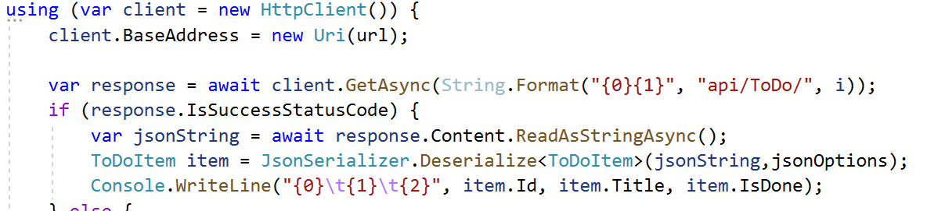

Call Web API from .Net Core application
Make a request using System.Net.Http.HttpClient
Use System.Text.Json.JsonSerializer to serialize and deserialize objects

Slide 32
Demo: Call a Web API
Notes:
Demo script:
Open the project ApiConsumerDemo
Show the code of the GetToDo method in Program.cs
Explain how the method GetAsync from HttpClient is used to execute a Get request on API
Explain that the result is a string that can be deserealized to an object using JsonSerializer
Show the code of AddToDo method in Program.cs
Explain how the content is serialized to a json string using JsonSerializer
Show how the Content-Type is set as application/json
Show the call to HttpClient PostAsync method
Start the WebApiDemo project
Start the ApiConsumerDemo and show the results

Slide 33
Module 5: Web API
Section 2: ASP.NET Core Web API
Lesson: Content Negotiation

Slide 34
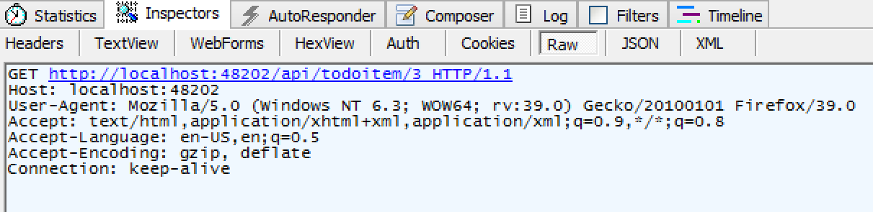
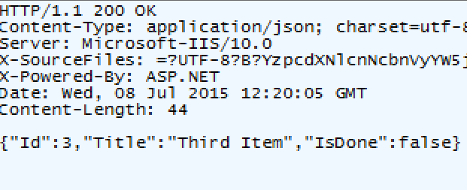
Content Negotiation
Apps consume content in different ways
JSON and Extensible Markup Language (XML) are the most popular formats
A good client will request the favored type
?
Notes:
The logic for choosing a formatter is similar to that in ASP.NET Web API, and based on the following order of precedence:
Accept header
Content-Type header
Selection based on type match
The basic rules can be described simply as:
The framework will attempt to return the format that the client asked for using the Accept header.
In absence of a specific format requested or inferred, the default format is JSON.
If the format the client asked for is not available the framework will return the default format JSON. (For example: accept header was application/DoesNotExistFormat)
For more information, see: https://docs.microsoft.com/en-us/aspnet/core/web-api/advanced/formatting?view=aspnetcore-3.1#content-negotiation

Slide 35
JSON Only By Default
XML formatters (input and output) are now removed by default
Custom formatters can be developed
Input formatters | Output formatters
JsonInputFormatter | JsonOutputFormatter
JsonPatchInputFormatter | StringOutputFormatter
 | StreamOutputFormatter
 | HttpNoContentOutputFormatter
Notes:
Since ASP.NET Core is a unified MVC/Web API framework, it is natural that the concept of formatters (previously only present in Web API) was brought forward to the new world.
However, in ASP.NET Core, formatters have been split into input- and output-formatters, instead of the traditional single, bi-directional formatter types that Web API used. Aside from that, the formatters are pretty much the same. They have to declare two things:
A flag whether they can read / write a given type - since a specific formatter may not be applicable to a specific type, for example not every user type can be represented as RSS
They read from request stream / write to response stream process
Output formatters should also define which content types they support.
Two input formatters:
JsonInputFormatter – Based on JSON.NET
JsonPatchInputFormatter - Based on JSON.NET
Four output formatters:
JsonOutputFormatter – Determined by JSON.NET
StringOutputFormatter – Utilized to force a string into a text/plain content sort
StreamOutputFormatter – Stream format
HttpNoContentOutputFormatter – Applied to force 204 status code for null action return

Slide 36
If You Need XML…
XML formatters are found in "Microsoft.AspNetCore.Mvc.Formatters.Xml" package
Manually add it to the formatters collection in Startup.cs
services.Configure<MvcOptions>(options =>
{
options.OutputFormatters.Add(new XmlSerializerOutputFormatter());
//options.InputFormatters.Add(new XmlSerializerInputFormatter());
});
Use the [Produces] attribute in the action method
[Produces("application/xml")]
public IActionResult GetAll(int id)
Notes:
In ASP.NET Core, the MvcOptions object (a short reminder that the framework configuration is controlled via it) recently got a new property RespectBrowserAcceptHeader, set by default to false.
It controls the new out-of-the box behavior, where ASP.NET Core, when selecting a formatter will try to sniff out the */* in the Accept header (meaning that the client declares it can handle any media type), and if it is there, will bypass any content negotiation and just select the first formatter capable of handling the given return type – which will normally be JSON formatter (unless you reordered formatters or injected some custom ones yourself).
Since out of the box ASP.NET Core is JSON only it does not have that big of an impact, but as soon as you plug in the XML formatters (or any other ones), you will notice that making a request from the browser’s address bar you still get JSON anyway.
You can switch off this behavior from the options:
services.Configure<MvcOptions>(options =>
{
options.RespectBrowserAcceptHeader = true;
});

Slide 37
Demo: Content Negotiation
Notes:
Demo script:
Open the project WebAPIDemo if you have closed it.
Download package "Microsoft.AspNetCore.Mvc.Formatters.Xml" from NuGet
//TODO 1: Uncomment the code below to register XML formatters in Startup.cs
//services.Configure<MvcOptions>(options =>
//{
// options.OutputFormatters.Add(new XmlSerializerOutputFormatter());
// //options.InputFormatters.Add(new XmlSerializerInputFormatter());
// options.RespectBrowserAcceptHeader = true;
//});
Add the corresponding using statements, if needed, accepting the recommendations from Visual Studio:
using Microsoft.AspNetCore.Mvc;
using Microsoft.AspNetCore.Mvc.Formatters;
//TODO 2: Uncomment the Prduces attribute below in ToDoController
//[Produces("application/xml")]
public IEnumerable<ToDoItem> GetAll(){…
Put a breakpoint on services.Configure<MvcOptions>(options … and show InputFormatters/OutputFormatters that come out of the box, hover the mouse over the options variable and display the contents of these collections.
Open Fiddler
Execute a GET request to http://localhost:PORT/api/todo and show the response in XML/JSON tabs. Now, you will get an XML response.
Execute a GET request to http://localhost:PORT/api/todo with Accept: application/json in the request header. Show the response in XML/JSON tabs (even you requested JSON, You will get an XML response because the action method has the Produces attribute only with XML!)
Execute a GET request to http://localhost:PORT/api/todo/3. Show the response in XML/JSON tabs (You will get a json response as expected)
Execute a GET request to http://localhost:PORT/api/todo/3 with Accept: application/xml in the request Header. Show the response in XML/JSON tabs. (You will get an XML response.)

Slide 38
Module 5: Web API
Section 2: ASP.NET Core Web API
Lesson: Open API (Swagger) Documentation
Notes:
Swagger is a language-agnostic specification for describing REST APIs. The Swagger project was donated to the OpenAPI Initiative, where it's now referred to as Open API.

Slide 39
OpenAPI (Swagger) Documentation
OpenAPI is a simple yet powerful representation of your RESTful API.
OpenAPI is the most popular representation of RESTful API.
Swagger is the tooling for OpenAPI specification
Swagger generates good documentation and help pages as a part of your Web API
Documentation is customizable:
XML comment from you code will be included
Data Annotation Attributes will be applied
Notes:
https://docs.asp.net/en/latest/tutorials/web-api-help-pages-using-swagger.html
https://swagger.io/blog/api-strategy/difference-between-swagger-and-openapi/

Slide 40
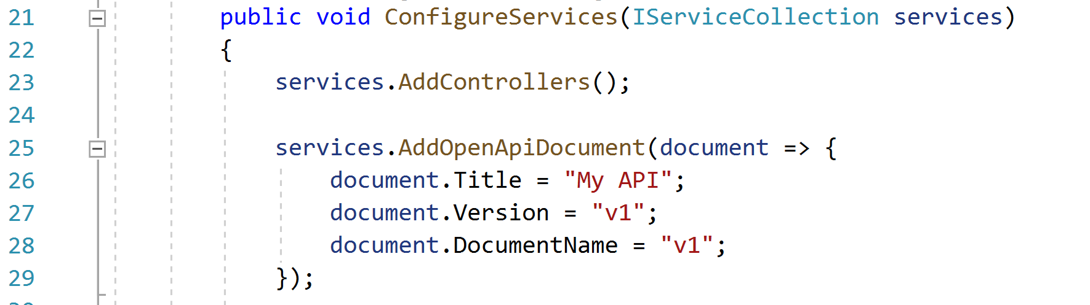
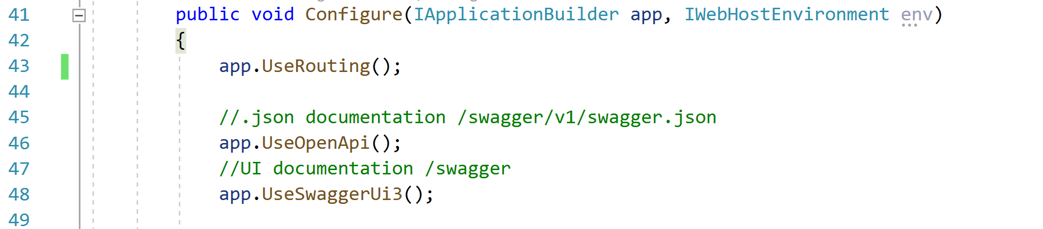
Open API (Swagger) configuration
Sample code using NSwag.AspNetCore
Notes:
This sample code uses NSwag.AspNetCore, explain that are other libraries that also implements OpenAPI documentation.

Slide 41
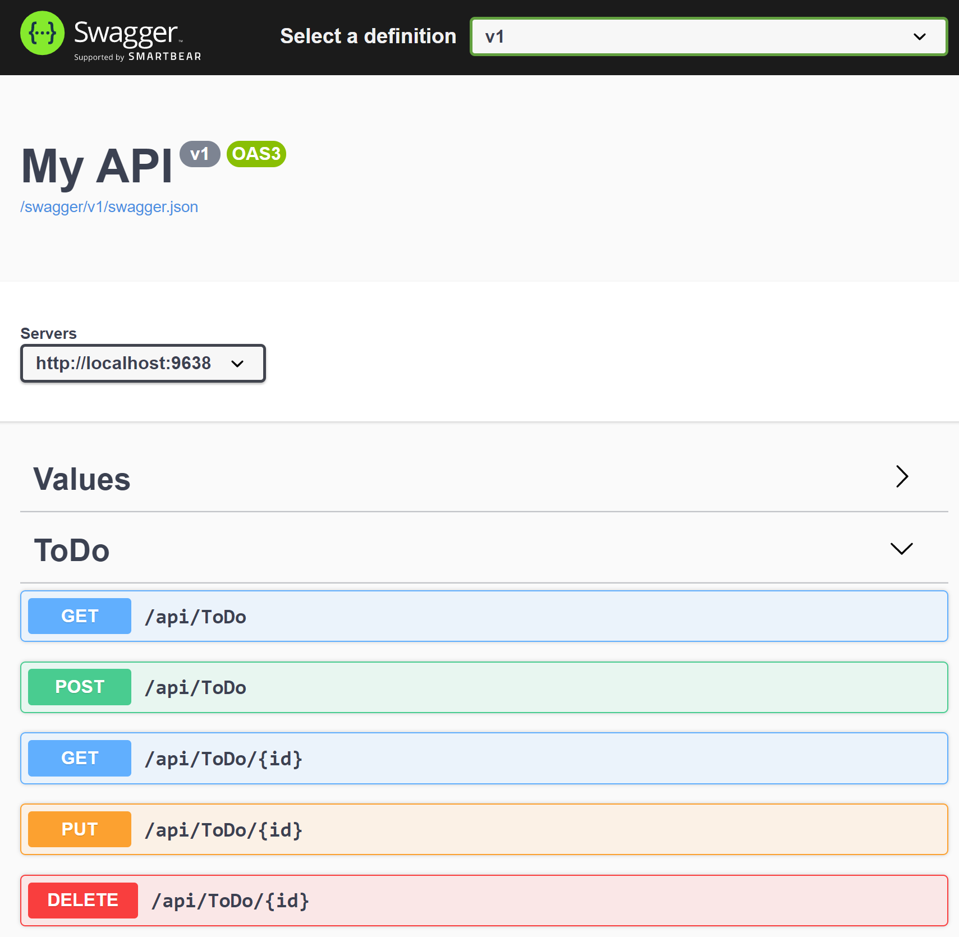
Open API (Swagger) UI example:

Slide 42
Demo: Open API (Swagger)
Notes:
Demo script:
Open the Startup.cs in the WebApiDemo Project
In the ConfigureServices method show the code that registers OpenAPI document as a service:
services.AddOpenApiDocument(document => {
document.Title = "My API";
document.Version = "v1";
document.DocumentName = "v1";
});
Show the code that configure application to use OpenAPI:
//.json documentation /swagger/v1/swagger.json
app.UseOpenApi();
//UI documentation /swagger
app.UseSwaggerUi3();
Run the application and access http://localhost:PORT/swagger to show the documentation. Explain that it was generated automatically from the code in the project.
Click the Try It Out button in any method and show that you can test methods.
Access the URL http://localhost:PORT/swagger/v1/swagger.json to show the documentation in json format. This format can be used by code generators to call API from applications.
For more information and configuration options go to: https://docs.microsoft.com/en-us/aspnet/core/tutorials/getting-started-with-nswag

Slide 43
Module 5: Web API
Section 3: Web API Usage Patterns
Lesson: Which Technology to Use?

Slide 44
SOAP and REST: Brief Comparison and Contrast
SOAP
Protocol
Uses HTTP for tunneling
REST
Architectural style
Leverages HTTP/Web
Operation/Message Centric
Resource-centric
Handles enterprise scenarios
Notes:
REST is architectural style and principles that you can use, when designing and providing services to take advantage of the underlying Restful web. SOAP on the other hand is a protocol and it is about services.
REST is simple and works like the web does. However, it does not support advanced scenarios covered by WS-* such as distributed transaction support, reliable messaging, advanced security (WS- Security). If your scenario has such requirements, then REST is not an option.
Resources are everything in REST and the same Uniform Interface is used to interact with each resource. SOAP on the other hand defines a single endpoint that exposes a proprietary interface to interact with potentially multiple resources. You can have multiple endpoints for each resource and this would be a move towards Restful, but you still have a non-uniform interface to interact with that resource (WSDL, web service).
Restful services utilize HTTP to stay true to RESTful principles. SOAP on the other hand simply uses HTTP as a transport mechanism to tunnel remote interactions.
REST is an architectural style that you can apply.
REST is simple and works. ST is like web.
REST is resource-centric and uses a Uniform Interface to interact with each resource.
Being Restful leverages the existing architecture of the web.

Slide 45
Which Technology To Use?
WCF | ASP.NET Web API
Multiple transport protocols (HTTP, TCP, UDP, and custom transports) | HTTP only. First-class programming model for HTTP
Web Services Description Language (WSDL) configuration file | Simple and lightweight
Multiple encodings (Text, MTOM, and Binary) | Wide variety of media types including XML, JSON etc.
Notes:
WCF is Microsoft unified programming model for building service-oriented applications. It enables developers to build secure, reliable, transacted solutions that integrate across platforms and interoperate with existing investments. (ASP.NET Web API is a framework that makes it easy to build HTTP services that reach a broad range of clients, including browsers and mobile devices. ASP.NET Web API is an ideal platform for building RESTful applications on the .NET Framework
Details can be found WCF vs WebAPI.xlsx

Slide 46
Which Technology To Use? (continued)
WCF | ASP.NET Web API
Services with WS-* standards | Basic protocol and formats such as HTTP, WebSocket, and SSL
Supports Request-Reply, One Way, and Duplex message exchange patterns. | HTTP is request/response
WCF SOAP services can be described | Variety of ways to describe a Web API
Ships with the .NET framework | Ships with .NET framework but is open-source and is also available out-of-band as independent download
Notes:
Use WCF to create reliable, secure web services that is accessible over a variety of transports. Use ASP.NET Web API to create HTTP-based services that are accessible from a wide variety of clients. Use ASP.NET Web API if you are creating and designing new REST-style services. Although WCF provides some support for writing REST-style services, the support for REST in ASP.NET Web API is more complete and all future REST feature improvements will be made in ASP.NET Web API. If you have an existing WCF service and you want to expose additional REST endpoints, use WCF and the WebHttpBinding.

Slide 47
Module 5: Web API
Section 3: Web API Usage Patterns
Lesson: Web API Design

Slide 48
Good API Design
There is no real standard or method for designing APIs
Keep your base URL simple and intuitive
Do not change your URLs over time
Notes:
You have to get the design right, because design communicates how something will be used. The question becomes - what is the design with optimal benefit for the app developer?
API development has been a very interesting and challenging type of web development in recent years. Scalability was not nearly as important early on in the Internet's history when there were less users, so standalone apps performed well for the most part. With the flood of different mobile devices, however, today's users are now able to use the same app from many different devices, which has resulted in developers needing to scale their apps.
With that said, it makes sense to create a common API that can easily and effectively scale to the ever-changing needs of the user rather than developing different standalone apps. Because there is several different technologies to create APIs, there is no real standard or method for designing APIs. However, there are several agreed-upon best practices for designing APIs correctly. In the absence of a real standard, it is hard to create rigid conventions. However, most of what is going to be discussed comes from real-world experience from moving legacy apps to an API model or creating a new API from scratch that is not only resilient and stable, but that is also scalable and fast.
The base URL is the most important design affordance of your API. A simple and intuitive base URL design makes using your API easy. Affordance is a design property that communicates how something should be used without requiring documentation.
No one likes to see a 404 error on a website, especially when someone has bookmarked a blog post or article for future use. It is a hassle for the user anytime a URL needs to be changed, and URL modification is not good for the SEO, either. Designing an API without the right abstraction might require changing the URLs later. Although redirects can solve this problem, it is a SEO best practice to avoid redirects. So, it makes sense to design the standards before you delve into API design and focus later on the specific details and business names before creating the URLs.

Slide 49
Nouns, No Verbs
Use nouns for resource names
Use plural rather than singular nouns, and concrete rather than abstract names
Keep verbs out of your base URLs
Use HTTP verbs to operate on the collections and elements
Tip: Nouns are good, verbs are bad
Actions that do not fit into the world of CRUD operations can be endpoint
GitHub's API
star a gist with PUT /gists/:id/star
unstar with DELETE /gists/:id/star
Notes:
How to pick the nouns for your URLs
Given that the first thing most people probably do with a RESTful API is a GET, we think it reads more easily and is more intuitive to use plural nouns. But above all, avoid a mixed model in which you use singular for some resources, plural for others. Being consistent allows developers to predict and guess the method calls as they learn to work with your API.
Achieving pure abstraction is sometimes a goal of API architects. However, that abstraction is not always meaningful for developers.
Take for example an API that accesses content in various forms - blogs, videos, news articles, and so on.
An API that models everything at the highest level of abstraction - as /items or /assets in our example - loses the opportunity to paint a tangible picture for developers to know what they can do with this API. It is more compelling and useful to see the resources listed as blogs, videos, and news articles.
The level of abstraction depends on your scenario.

Slide 50
Simplify Associations
Nested resources(Association)
User URI navigation (/resource/identifier/resource)
GET /api/Customers/123/Invoices
GET /api/Customers/123/Payments
GET /api/Customers/123/Shipments
Keep the base resource URLs lean by implementing query parameters
GET /api/Customers?state=GA
GET /api/Customers?hasOpenOrders=true
Notes:
Resources almost always have relationships to other resources. What is a simple way to express these relationships in a Web API?
You should not need too many cases where a URL is deeper than what we have above /resource/identifier/resource
Sweep complexity behind the ‘?’ Most APIs have intricacies beyond the base level of a resource. Complexities can include many states that can be updated, changed, queried, as well as the attributes associated with a resource.
Make it simple for developers to use the base URL by putting optional states and attributes behind the HTTP question mark.
In summary, keep your API intuitive by simplifying the associations between resources, and sweeping parameters and other complexities under the rug of the HTTP question mark.

Slide 51
Use Meaningful HTTP Status Codes
Use HTTP status codes and map them cleanly to relevant standard-based codes
Group | Comment
1xx | Informational (100, 101)
2xx | Success (200, 201)
3xx | Redirect (301, 304)
4xx | Client Error (401, 404, 405)
5xx | Server Error (500, 503)
Notes:
From the perspective of the developer consuming your Web API, everything at the other side of that interface is a black box. Errors therefore become a key tool providing context and visibility into how to use an API.
There are only three outcomes in the interaction between an app and an API:
Everything worked - success
The application did something wrong – client error
The API did something wrong – server error
Make messages returned in the payload as verbose as possible.
Code for code
200 – OK
401 – Unauthorized
Message for people
{"developerMessage" : "Verbose, plain language description of the problem for the app developer with hints about how to fix it.", "userMessage":“ Pass this message on to the app user if needed.", "errorCode" : 12345, "more info":

Slide 52
Versioning
Never release an API without a version and make the version mandatory
Maintain at least one version back
Versioning with Content Negotiation and custom headers are popular now
Content-Type: application/json;v=2
X-MyApp-Version = 2
Versioning with URI components are more common
Easier to implement
GET /api/v2/Customers/123/Invoices
Check the Microsoft.AspNetCore.MvcVersionig Nuget package
Notes:
Versioning with custom headers:
Pros
Separates Versioning from API call
Not tied to resource versioning (e.g. content type)
Cons
Adds complexity – Adding headers is not easy on all platform
Versioning with content negotiation:
Pro(s)
Packages API and Resource Versioning in one
Removes versioning from API so clients do not have to change
Con(s)
Adds complexity – Adding headers is not easy on all platforms
Can encourage increased versioning which causes more code churning
Versioning with URI:
Pro(s)
Simple implementation
Ensure browser explorability
Con(s)
URL representing a resource is NOT stable across versions
Simple rules to follow:
If it changes the logic you write to handle the response, put it in the URL so you can see it easily. If it does not change the logic for each response, like OAuth information, put it in the header.
More Info
https://github.com/microsoft/api-guidelines/blob/vNext/Guidelines.md#12-versioning
https://github.com/Microsoft/aspnet-api-versioning/wiki
https://www.nuget.org/packages/Microsoft.AspNetCore.Mvc.Versioning

Slide 53
Demo: API Versioning
Notes:
Demo script:
Open the ApiVersioningDemo Project
In Solution Explorer expand Dependencies->Packages and show that application is using Microsoft.AspNetCore.Mvc.Versioning package
Open Startup.cs and show the code that configures API versioning:
public void ConfigureServices(IServiceCollection services) {
services.AddControllers();
services.AddApiVersioning(o => {
o.AssumeDefaultVersionWhenUnspecified = true;
});
}
Open Controllers\WeatherForecastController.cs and show the versioning attribute and routes in the class declaration. This is v1 version of the API:
[ApiVersion("1.0")]
[Route("[controller]")]
[Route("v{version:apiVersion}/[controller]")]
public class WeatherForecastController : ControllerBase { …
Open Controllers\WeatherForecastControllerV2.cs and show the same attributes in the class declaration. This is v2 version of the API:
[ApiVersion("2.0")]
[Route("v{version:apiVersion}/WeatherForecast")]
public class WeatherForecastControllerV2 : ControllerBase {…
Run the application and navigate to http://localhost:PORT/weatherforecast, show the version in the response.
Do the same for http://localhost:PORT/v1/weatherforecast and http://localhost:PORT/v2/weatherforecast

Slide 54
Caching
Implement caching carefully
Time-based (Last-Modified)
When generating a response include a HTTP header Last-Modified
Last-Modified: Thu, 29 Aug 2019 16:24:26 GMT
When generating a request, include a HTTP header If-Modified-Since
If-Modified-Since: Thu, 29 Aug 2019 16:24:26 GMT
If an inbound HTTP requests contains a If-Modified-Since header, the API should return a 304 Not Modified status code instead of the output representation of the resource
Content-based (ETag)
Hash based on the content sent as HTTP header in a response
ETag: "5d67fc3c-4a5f“
If-none-match HTTP header in request with same hash
If-None-Match: " 5d67fc3c-4a5f“
Useful when the last modified date is difficult to determine
Notes:
There will be caches involved no matter what, and they are an important part of the web. Help the caches by adding proper cache headers, e.g. if you do not want caching, be explicit and turn them off.
One of the better ways of controlling caching is to use validators, preferably Etags. They allow the server side to act on arbitrary data, an Etag is just a value the server generates and passes to the cache, the cache later on passes the Etag back, asking the server if the resource if fresh or not
Implementation details on: https://www.maxcdn.com/one/tutorial/specify-cache-validators/
General info about ETAG

Slide 55
Demo: ETag
Notes:
Demo script:
//TODO 3: Uncomment the following line to use ETag middleware in Startup.cs
//app.UseETagHeaderMiddleware();
Run the app and Fildder
In Fiddler open composer and make a first call to http://localhost:PORT/api/ToDo
In the response body show that server return some etag information
HTTP/1.1 200 OK
Content-Type: application/json; charset=utf-8
ETag: 19F9AF16BAB2163BE766D1A3FC4AE2B0
[{"id":1,"title":"Item1","isDone":false},{"id":2,"title":"Item2","isDone":false},{"id":3,"title":"Item3","isDone":true}]
Copy the value of ETAG to Fiddler Composer windows as a header if-none-match
If-None-Match: 19F9AF16BAB2163BE766D1A3FC4AE2B0
Make one more call. In a response you will see the status code 304- content no changed and body size 0 bytes
HTTP/1.1 304 Not Modified
Content-Type: application/json; charset=utf-8
Explain that this middleware is a custom component and optionally show the contents of the ETagMiddleware.cs.

Slide 56
Security
Do you need to secure your API?
Are you? | Secure?
Using private or personalized data | Yes
Sending sensitive data across the wire? | Yes
Using credentials of any kind | Yes
Trying to protect overuse of your servers? | Yes

Slide 57
Security
Do not expose your domain model
Always use SSL
Secure the API itself
HTTP Basic Authentication
API token keys
Custom authentication mechanism with cookies or token
JWT tokens
OAuth
Notes:
Domain model: A significant issue in general is that the controller exposes the database objects and other information in its return data. Typically this information is unnecessary to consumers of the API and frequently also relies on domain-specific or sensitive information that should not be exposed. The leakage of this sort of information is especially important when the API could potentially reveal personally identifiable information, the exposure of which could be illegal.
OAuth:
Use the latest OAuth version. It means that Web or mobile apps that expose APIs do not have to share passwords. It allows the API provider to revoke tokens for an individual user, for an entire app, without requiring the user to change their original password. This is critical if a mobile device is compromised or if a rogue app is discovered.

Slide 58
Demo: Web API Security using simple Key
Notes:
Demo script:
Open project Demos\Module 05 - WebApi\SecurityKeysAccessDemo.
Run the app and ensure that you are using https (on iisexpress).
Open ValuesController and show that the controller is marked with two attributes.
[RequireHttps] – to enforce https
[KeyFilter]- our custom filter that will validate that client has a valid subscription key to gain access to the API.
Open KeyFilter implementation and show how we can check key in a request header. It’s just a demo, and you may implement key storage and key validation in a more sophisticated way.
Open Fiddler and call https://localhost:PORT/api/values via composer.
Show the response. The response will have: “Access Key required”
Add header to a fiddler request “MySecurityKey: 09ECA49C-0137-4427-AEC1-2B23C4B6ADB9”.
Demonstrate that we now have a normal response from API with data.

Slide 59
Security
JWT tokens
Open standard (RFC 7519)
JSON
Compact and self-contained way for securilly transmit informations between parties
Signed using secrets (HMAC) or public/private key pair (RSA)
Base64 encoded
Can be sent through URL, POST or HTTP header
Used by authentication flows like OAuth and OpenId Connect
Normally are only signed and not encrypted. Always use over HTTPS/SSL.
Notes:
Good introduction here: https://auth0.com/learn/json-web-tokens/
To decode tokens online: https://jwt.io/

Slide 60
Security
Configure application to authorize with JWT tokens:
public void ConfigureServices(IServiceCollection services){
…
var key = Encoding.ASCII.GetBytes(appSettings.Secret);
services.AddAuthentication(aut => {
aut.DefaultAuthenticateScheme = JwtBearerDefaults.AuthenticationScheme;
aut.DefaultChallengeScheme = JwtBearerDefaults.AuthenticationScheme;
})
.AddJwtBearer(o => {
o.RequireHttpsMetadata = false;
o.SaveToken = true;
o.TokenValidationParameters = new TokenValidationParameters {
ValidateIssuerSigningKey = true,
IssuerSigningKey = new SymmetricSecurityKey(key)
};
});
Notes:
This is the code from the demo.
It is worth to mention that this is code for a generic JWT token authentication and that packages exist for authentication using providers like Azure AD, Facebook, Twitter, ....

Slide 61
Security
How to generate JWT tokens:
…
var tokenHandler = new JwtSecurityTokenHandler();
var key = Encoding.ASCII.GetBytes(_appSettings.Secret);
var tokenDescriptor = new SecurityTokenDescriptor{
Subject = new ClaimsIdentity(new Claim[]{
new Claim(ClaimTypes.Name, user.UserName)
}),
Expires = DateTime.UtcNow.AddDays(2),
SigningCredentials =
new SigningCredentials(new SymmetricSecurityKey(key),
SecurityAlgorithms.HmacSha256Signature)
};
var token = tokenHandler.CreateToken(tokenDescriptor);
user.Token = tokenHandler.WriteToken(token)
…
Notes:
This code is here just as a sample for a hypothetical security token server, is used in the demo to simulate authentication and authorization token generation, it is highly recommended to use tested and supported solutions, like Identity Server, for real life scenarios.

Slide 62
Demo: Web API Authorization with Jwt Token
Notes:
Demo script:
Open JwtTokenAccessDemo Project
Open Controllers\WeatherForecastController, show that it is decorated with [Authorize] attribute and explain that is necessary authentication to access actions in this controller.
Start the application and open Fiddler.
In the Composer tab in Fiddler issue a GET request to https://localhost:PORT/weatherforecast .
You should receive a HTTP 500 status code, explain that it occurs because authentication was not configured yet.
Open Startup.cs, look for:
//TODO 4: Uncomment the lines below to register authentication
//var key = Encoding.ASCII.GetBytes(appSettings.Secret);
//services.AddAuthentication(aut =>
…
////=========
Uncomment the code and explain that this code configure application to use Jwt tokens authorization.
Open the appsettings.json and show that we using a shared secret to generate and validate the tokens:
{
"AppSettings":{
"Secret": "ad3aac35ccdeed3e315abca1ebace3bad2d24bada3ece4ceb5"
},
Start application again and repeat the request in Fiddler, this time the HTTP status code will be 401 indicating the absence of authorization info.
Open de request details in Fiddler and show the WWW-Authenticate: Bearer in response headers.
Go back to Composer and issue a POST request to https://localhost:POST/authenticate :
Add a Content-Type: application/json header
Add the following json as a body (you can pass any values, the format is important):
{
"UserName":"User123",
"Password":"P@ssw0rd"
}
Display the request details and show the token in the body of response.
Open Controllers\Authenticator.cs and explain that this code simulates the user authentication and generates a Jwt token with claims for the user. This token is signed with the secret in appsettings.json.
Copy the token.
In Composer open the GET to https://localhost:PORT/weatherforecast :
Add the following header :
Authorization:Bearer eyJhbGciO… (the token copied from previous step)
Now you should receive a HTTP status code 200 with the protected WeatherForecast data.
Optionally go to jwt.io site to decode the token and show data.

Slide 63
Module 5: Web Api
Section 4: .NET gRPC Support
Lesson: Introduction to gRPC
Notes:
The purpose of this lesson is just give to students a brief introduction to gRPC and how it is implemented in .NET Core

Slide 64

What is gRPC
Modern, open source remote procedure call (RPC) framework that can run anywhere
Enables client and server applications to communicate transparently
Makes it easier to build connected systems
Point-to-point real-time services that need to handle streaming requests or responses.
https://grpc.io/

Slide 65
gRPC use cases
Efficiently connecting polyglot services in microservices style architecture
Support for more than 10 languages:
C/C++, C#, Dart, Go, Java, Kotlin/JVM, Node.js, Objective-C, PHP, Python, Ruby
Connect mobile devices to backend services
Generate efficient client libraries
Notes:
As a RPC framework gRPC is an efficient replacement for HTTP/Rest for inter services communications in a services based application scenarios.
Can also be used for communications between device applications and services.
There are some frameworks now for communications between browser applications and services using gRPC but, at the time of writing, the implementations are in initial stages.
More information: https://grpc.io/blog/state-of-grpc-web/

Slide 66
HTTP/2
gRPC is built on top of HTTP/2
HTTP/2 is a replacement for HTTP representation “on the wire”
Keeps the methods, status codes and semantics of HTTP
Focus on performance and low latency
Key, high level, differences to HTTP/1.x?
Binary, instead of textual
Fully multiplexed, instead of ordered and blocking
Can use single connection for parallelism
Header compression to reduce overhead
Allow servers to “push” responses proactively into client caches
Notes:
For more information check:
https://http2.github.io
https://http2.github.io/faq

Slide 67
.NET Core support for gRPC
C# Tooling Support for .proto files
Project template for gRPC services
C# client development
Currently (May 2020) not supported on Azure App Service or IIS
Notes:
From documentation:
Warning!
ASP.NET Core gRPC is not currently supported on Azure App Service or IIS.
The HTTP/2 implementation of Http.Sys does not support HTTP response trailing headers which gRPC relies on. For more information, see this GitHub issue (https://github.com/dotnet/AspNetCore/issues/9020).

Slide 68
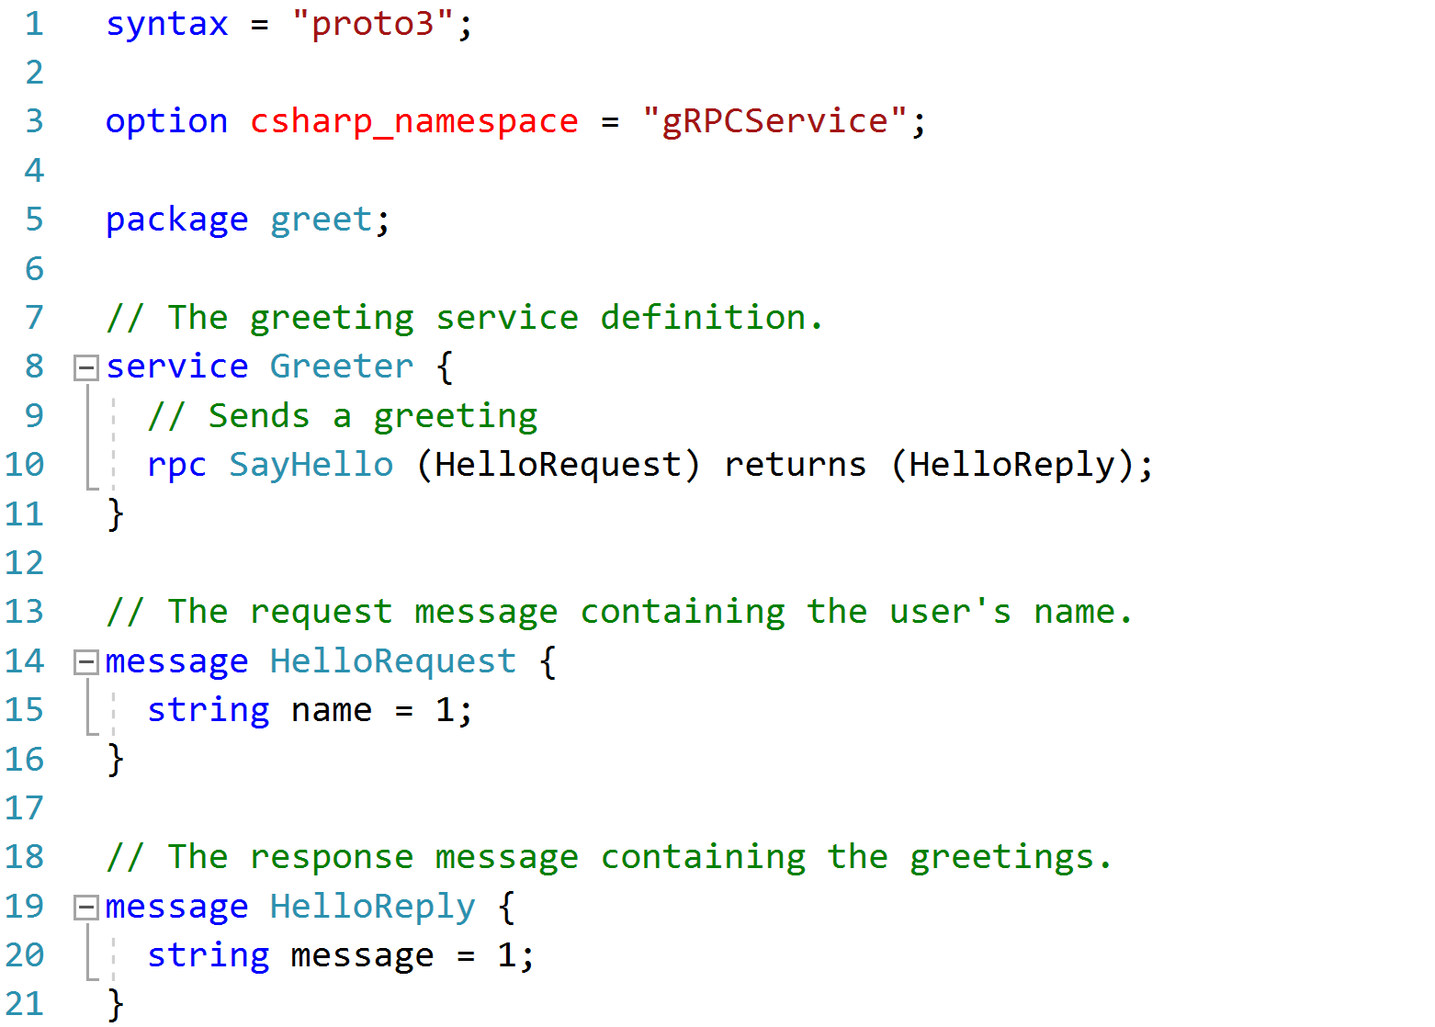
Protocol Buffers (.proto files)
Notes:
This and the next slides display code from the demo files, if you prefer skip the slides and go straight to Visual Studio for demoing the code.
.proto files define the interfaces and message formats for the services
For details see: https://developers.google.com/protocol-buffers/docs/proto3

Slide 69
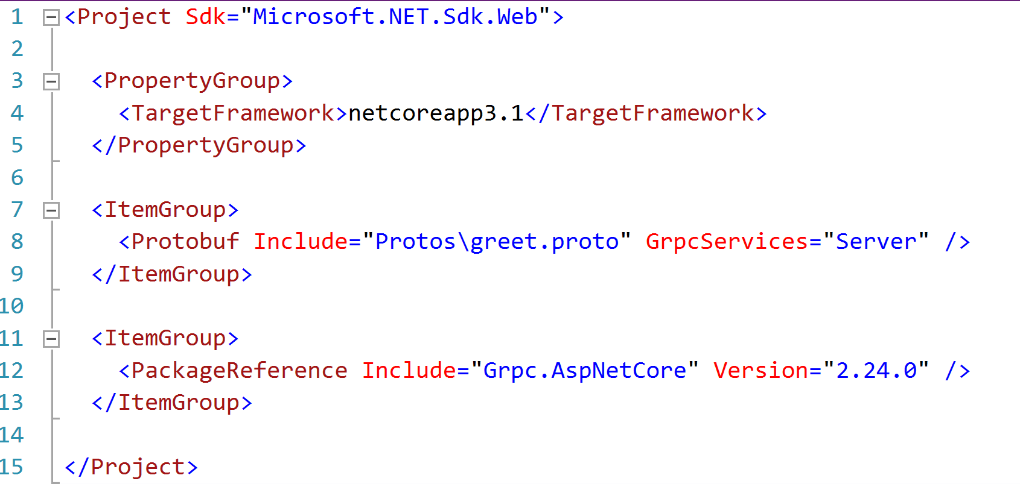
Project file (.csproject)
References for the .proto files and the Grpc.AspNetCore
Notes:
The Grpc.AspNetCore package includes the tooling that converts the .proto files into .cs code during build.

Slide 70
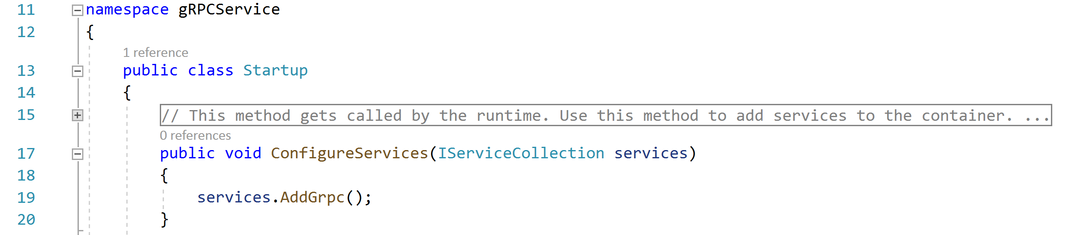
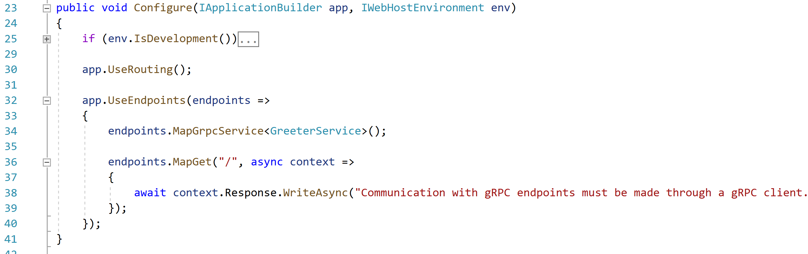
Configuration – Startup.cs

Slide 71
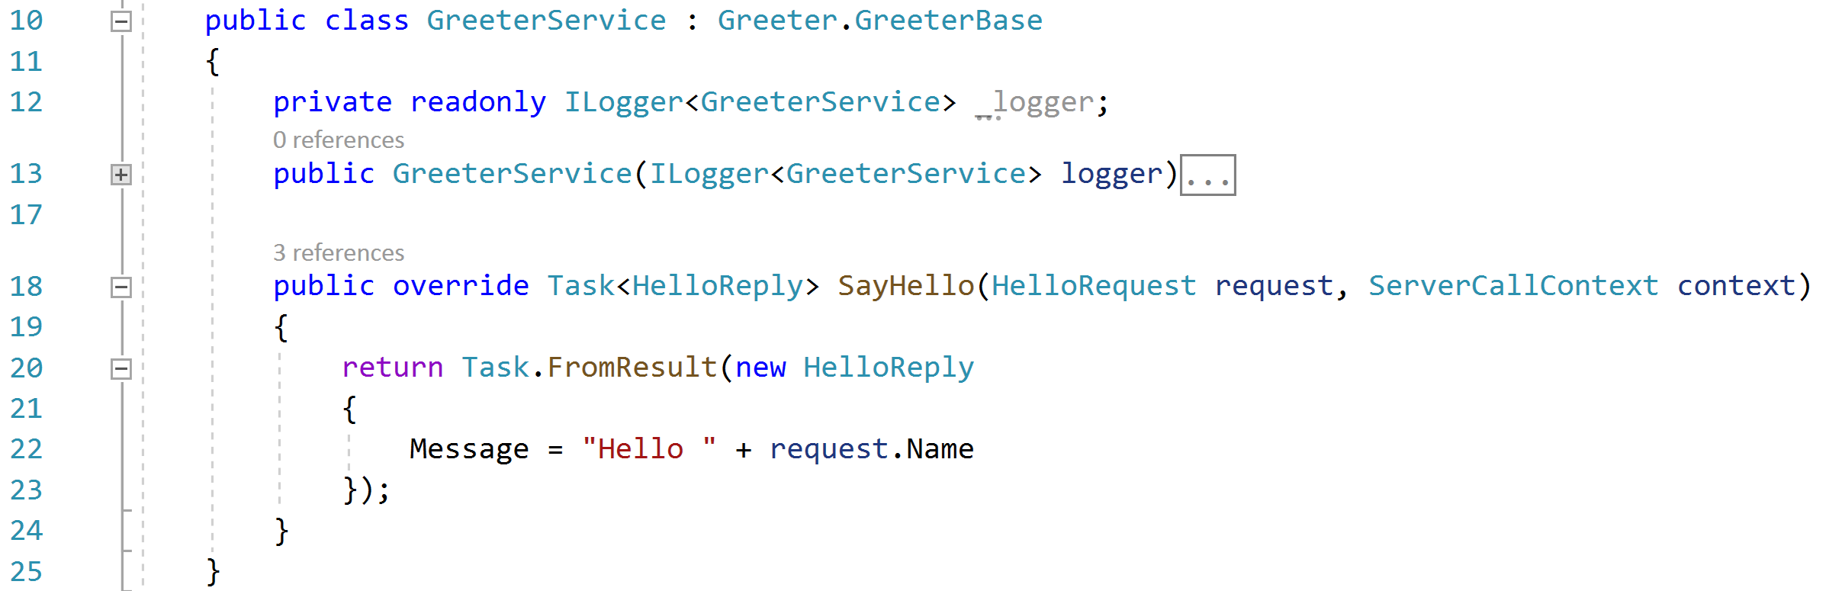
gRPC services on ASP.NET Core

Slide 72
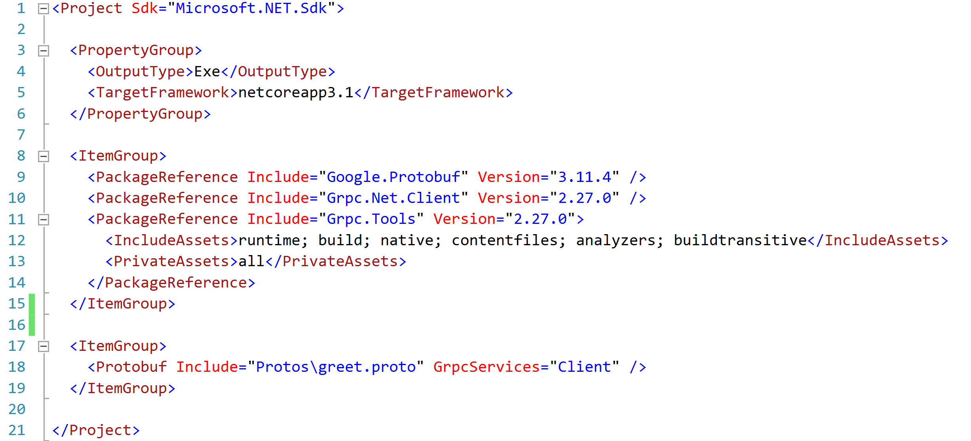
gRPC clients – Project file
Notes:
Important to note here that clients must use .proto files with the same definitions of the services.
The Grpc.Tools package is used only in development time thus it is marked as PrivateAssets.

Slide 73
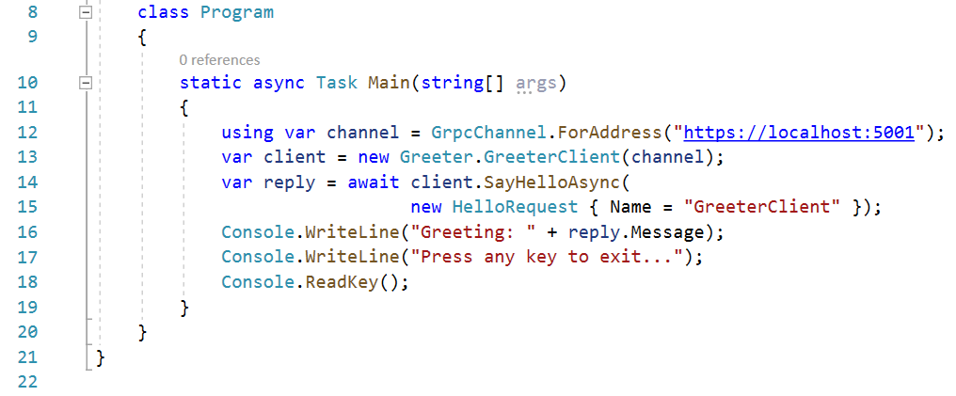
gRPC clients calling services
Channel is a long-lived connection to a gRPC service
The client is created using a channel
The client is a concrete type generated from .proto files

Slide 74
Demo: simple gRPC client and server
Notes:
In Solution Explorer for Module5 Solution, expand the gRPCDemo folder and execute the gRPCService project
Try to open the url HTTPS://localhost:50001 in the browser and show the message explaining that the service must be consumed by a gRPC client
Run the gRPC client and show that the client can communicate with the service using gRPC
Optionally show the code in Visual Studio if you decided to skip the slides or to reinforce some points.
The demo comes from getting started tutorial on .NET docs: https://docs.microsoft.com/en-us/aspnet/core/tutorials/grpc/grpc-start?view=aspnetcore-3.1&tabs=visual-studio

Slide 75

Module Summary
In this module, you learned about:
REST principles
Web API fundamentals
Web API routing
Content negotiation
Web API Design
gRPC Introduction

Slide 76
Lab: ASP.NET Web API

Slide 77


